Slide 1




Sales Forecasting
&Demand
Prediction
DEPI Final Project
2025

Slide 2

Team Members:
No. | Name | ID | Task
1 | Mohammed Kadry Hussein | 21101773 | Part 1_Milestone 1 Part 1_Miestone 3
2 | Mahmoud Hamdy Ali | 21068016 | Part 2_Milestone 1 Part 2_Miestone 3
3 | Sahar Gamal Soliman | 21104497 | Part 1_Milestone 2 Part 1_Miestone 4
4 | Fatma Salah Mohammed | 21104482 | Part 3_Milestone 1 Miestone 5
5 | Tasneem Shehab Eldin Mahmoud | 21070870 | Part 2_Milestone 2 Part 2_Miestone 4

Slide 3

3
01
Project Idea
02
Project Wireframe
03
End Users + Features
CONTENT
04
Data Structure
Programming Languages
+ Frameworks
05
06
Deliverables

Slide 4

4
1. Project Idea :
Problem Description
Businesses struggle to accurately predict future sales and demand, which leads to poor inventory planning, inefficient marketing decisions, and potential revenue loss.
Proposed Solution
Develop a machine learning–based forecasting system that analyzes historical sales data and predicts future sales and demand.
The solution will include:
A predictive model
Automated data preprocessing
Visualization dashboard to help decision-makers understand trends
Tools for monitoring and updating the model

Slide 5
5
1. Project Idea :
Unique Value Proposition
High prediction accuracy using advanced machine learning models
User-friendly dashboard that simplifies data-driven decision-making
Scalability, allowing the system to work for any product category or business size
Automation, reducing manual analysis time
Actionable insights, enabling better planning for inventory, marketing, and operations

Slide 6
6
2. Project Wireframe
Key Screen: User Data Input & Prediction
Input Section: Product ID, Customer ID, Order details
Submit Button: Sends data for prediction
Output Section: Forecasted Sales & Demand (numbers + charts)
Optional Alerts: Highlights significant changes in demand
User Journey
User navigates to Data Input Screen
Enters required details about product/order
Clicks Submit to send data
System processes the input and runs the ML model
User receives predictions and visual insights

Slide 7
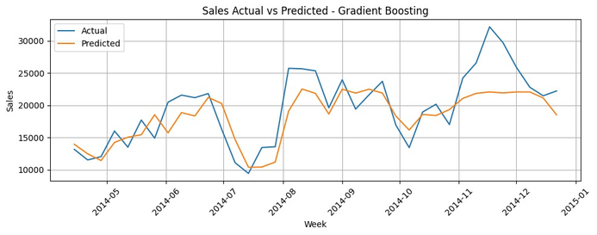
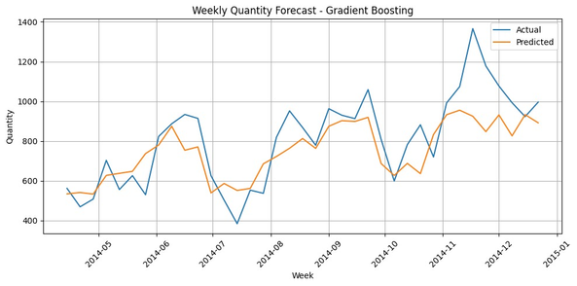
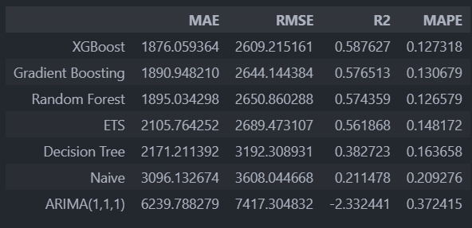
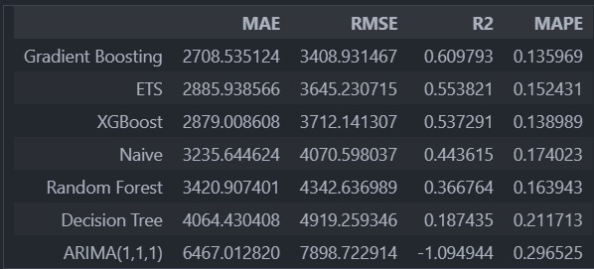
7
2. Project Wireframe
Model Performance
The table below summarizes the performance of the different forecasting models evaluated on the dataset.
The metrics include Mean Absolute Error (MAE), Root Mean Squared Error (RMSE), R² Score, and Mean Absolute Percentage Error (MAPE), which collectively provide insights into prediction accuracy and reliability.

Slide 8
8
3. End Users + Features
End Users
Business Owners & Managers
Inventory & Supply Chain Teams
Marketing Teams
Data Analysts / Data Science Teams
Key Features
Sales & Demand Forecasting
Interactive Dashboard
Automated Data Pipeline
What-If Scenario Simulation
Alerts & Notifications
Model Performance Monitoring

Slide 9
9
3. End Users + Features
How the Features Solve User Problems
Business Owners & Managers:
Forecasts support better decision-making and strategic planning.
Inventory & Supply Chain Teams:
Demand predictions reduce overstock and prevent stockouts.
Marketing & Strategy Teams:
Scenario analysis helps plan effective marketing actions.
Data Analysts & Data Science Teams:
Automation and monitoring simplify model maintenance.

Slide 10
10
4. Data Structure (CSV-based)
Some Features
Order Date, Ship Date → Track order timing and shipping duration
Product ID, Category, Sub-Category → Track product types and categories
Customer ID, Segment, Region → Analyze customer behavior and segmentation
Total Sales, Quantity → Main target variables for forecasting
Shape of Data
Rows: 44,119 orders
Columns: 44 features

Slide 11
11
4. Data Structure (CSV-based)
Data Balance
Distribution of sales and demand is imbalanced across products and regions
Some products or regions appear more frequently than others
Techniques Used
Handling missing values
Encoding categorical variables into numerical form
Feature engineering: lag features, rolling averages
Scaling of numerical features
Splitting data into training and testing sets

Slide 12
12
5. Programming Languages + Frameworks
Programming Languages
Python → Main language for data analysis, preprocessing, and machine learning
JavaScript / HTML / CSS → For dashboard interactivity
Frameworks / Tools
Pandas & NumPy → Data manipulation and numerical operations
Scikit-learn / XGBoost → Machine learning models for sales and demand prediction
Matplotlib & Seaborn / Plotly → Data visualization and charts
Streamlit → Building interactive dashboards
Supporting Technologies
APIs → For fetching external data.
CSV / Excel Files → Data input
Cloud Platforms (e.g., Google Colab) →Used for running Python code, data preprocessing, and training machine learning models in the cloud

Slide 13
13
6. Deliverables
Reports & Documentation
Milestone Reports: 4 milestone reports covering each development phase
Monitoring Documentation: Reports on model performance and updates
Final Project Report: Comprehensive summary of methodology, results, and insights
Source Code& Data
Milestone Codes: Python scripts for all 4 milestones
Data Files: Original CSV data + all modifications and preprocessing steps
Fully documented and ready for review
GitHub Repository: Link to full project, code, and data ( GITHUB LINK )
Other Final Products
Working Application: Functional sales forecasting and demand prediction system
Presentation Slides: Final slides summarizing project and results

Slide 14




THANK YOU !
+20 12 00362964
mokadry2004@gmail.com
https://www.linkedin.com/in/mohamed-kadry-bba826254/

